Slide 1
Loops

Slide 2
Loops
Loops are a way to repeat code multiple times.
They are good way to allow more flexibility in your code.
They allow you to perform code a different number of times based on what is happening or has happened in your code.
There are two types of Loops. For and While.
In many situations they can both be used, but most situations work better or are easier to code with one.
Just like conditionals, indentation is very important. Everything in a loop must be indented.

Slide 3
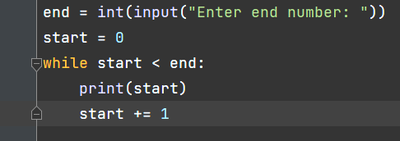
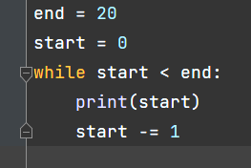
While Loops
While loops run as long as the given condition returns a True boolean.
Think of it like a repeating if statement.
These are great for doing things like making sure someone inputs the correct thing, or an update loop that every second prints text.
Be careful of creating infinite loops.

Slide 4
Example
Create a while loop that prints every integer from 1 to 10.

Slide 5
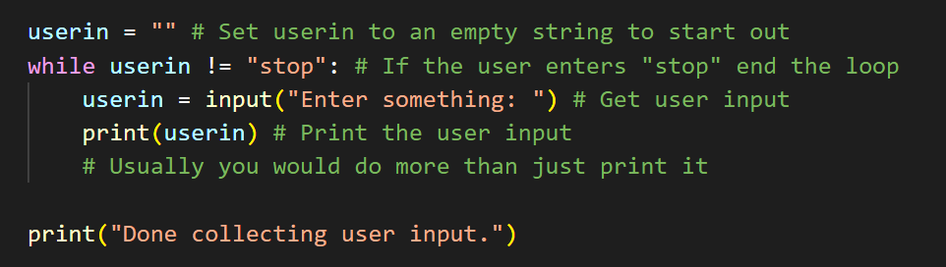
While Loops and User Input
While loops are often paired with user input. The condition for the loop might be what the user needs to enter to stop the loop. The user is prompted for input each time it loops, and something happens based on that input.
This allows you to take user input multiple times without writing multiple lines of input(). It also allows the user to control how much input they give.

Slide 6
Exercise
Improve the login system we wrote last class to allow multiple attempts. You’re developing a login system for a website. Write a Python program that checks whether the user has entered the correct username and password. Just like before:
Create two variables called username and password.
Prompt the user to enter their username and password.
Use conditionals and logical operators to check whether the username and password entered by the user match the username and password variables.
As long as the username and password are incorrect, print “Incorrect username or password”, and keep asking the user for their username and password.
If they match, print “Login successful” and end the program.

Slide 7
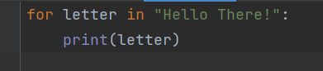
For Loops
For loops are used to iterate through something.
For loops perform an action on a group of objects.
For loops can be performed on iterables:
Strings
Lists
Tuples
Dictionaries
Sets
…etc.

Slide 8
For Loops
A Python keyword, meaning that each item is in the collection
for item in collection:
print(item)
The name of an existing variable. This must be an iterable - a collection of items - such as a string, list, etc. defined before the for loop
A temporary variable that doesn’t already exist. This steps through every item in collection. You can name it whatever you want. It disappears (goes out of scope) once the for loop ends.

Slide 9
Example
Write a for loop that loops through a string, counts all the letters, and then print how long the string is.

Slide 10
Exercise
Take a string from the user. Verify that it’s a number.
Write a for loop that adds all the digits together. Then print the total.
Example:
'14253'
15
Hint: remember to cast to int() for each digit in the loop

Slide 11
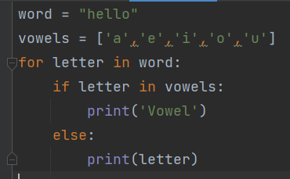
Conditionals in Loops
Adding conditionals to loops is a great way to make a loops code more dynamic.
They allow us to do different things based on what is happening in the loop.
They also are an easy way to evaluate if a while loop should end.

Slide 12
Exercise
Write some code that will loop through a string and print whether each letter is a vowel or consonant.
Example:
'hello'
h is a consonant
e is a vowel
l is a consonant
l is a consonant
o is a vowel

Slide 13
Exercise - Cleaning Strings
You’re working on a data analysis project for a company that looks at written text. You’re only interested in letters from A-Z because you’re analyzing language. However, the data you’re given has some values that shouldn’t be there.
Write a Python program that takes a string as input from the user, removes anything from the string that isn’t a letter, and prints the new string.
You can loop through the string in a for loop, use the .isalpha() string method, and remember that strings are immutable, so you will have to build a new string from scratch using string concatenation.

